Slide 1
A NEW SPEECH DATABASE FOR WITHIN- AND BETWEEN-SPEAKER VARIABILITY
Pat Keating,
Jody Kreiman, Abeer Alwan
U California, Los Angeles
19th International Congress of Phonetic Sciences
Melbourne, August 6 2019

Slide 2
Motivation for the Database
Voice variability:
Within-speaker variability: Any one speaker’s voice varies constantly, so that no speaker’s voice is fixed, but rather exhibits a distribution of qualities
Between-speaker variability: Voice quality differs among speakers – sometimes greatly, sometimes minimally

Slide 3
Within- vs. between-speaker variability
Often assumed that within-speaker variability is markedly and reliably less than between-speaker variability
If true, makes speaker discrimination/recognition relatively easy
To test, need a speech database that provides significant variability of both kinds
Wolf 1972, Nolan 1983, Kinnunen & Li 2010

Slide 4
Existing English databases
See paper for review
None of the databases we were aware of offered the desired combination of
many speakers (male and female) – between-speaker variability
multiple recording sessions per speaker within-speaker
multiple speech tasks per speaker variability
repeated text – allows text-dependent analysis
very high-quality audio
Hence the UCLA Speaker Variability Database
Sturim et al. 2016

Slide 5
Speakers
238 UCLA undergraduates (116 male, 122 female) have completed all sessions/tasks
Corpus is entirely in English, but speakers’ language backgrounds vary:
monolingual native speakers of English
bilingual native speakers of English
L2 speakers of English
Most L2 English speakers started learning English < age 10

Slide 6
Speaker similarity vs. diversity
We want to sample speakers who are
homogeneous/similar enough to make telling their voices apart challenging
but with some sources of between-speaker variability, here
sex
language background

Slide 7
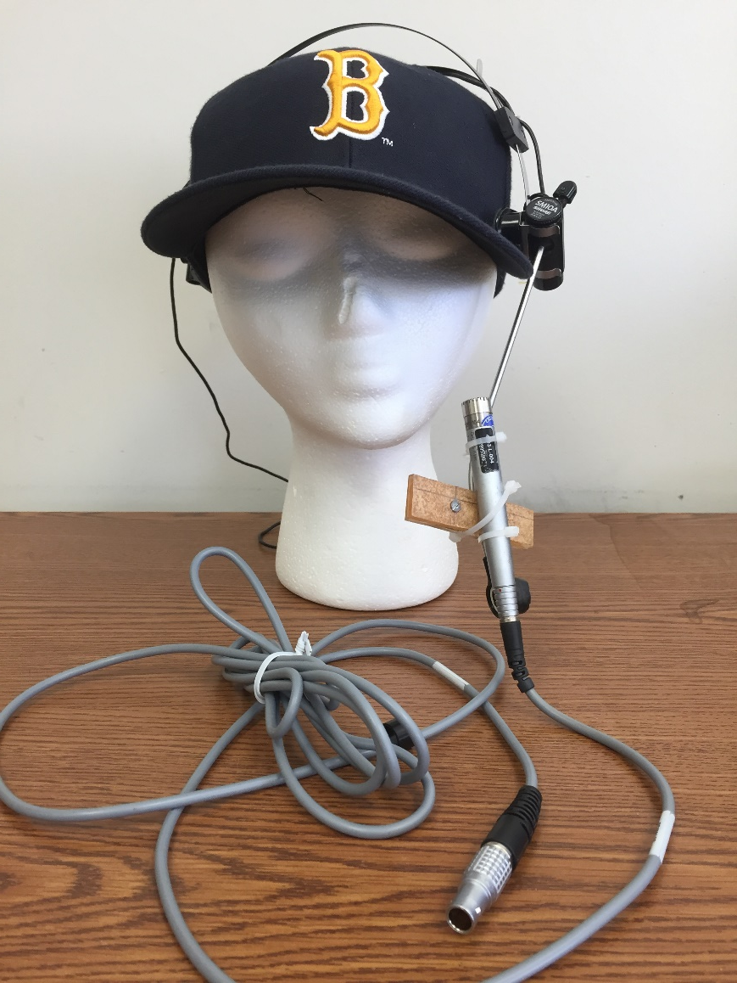
Recording conditions
UCLA Phonetics Lab’s sound-attenuated booth
Bruel & Kjaer microphone suspended rigidly from a head-mount over a baseball cap worn by the speaker
Recording prompts presented on-screen
Direct-to-disk at 22k using PCQuirerX and its box
Sessions on 3 separate days (A, B, C)
Following slides show the various speech tasks

Slide 8
Isolated vowels task (scripted)
Vowel /ɑ/ 3 times, ~1-2 sec each
In each session, so 9 tokens total

Slide 9
Read sentences task (scripted)
5 Harvard sentences (IEEE 1969), read twice in each session, randomized
So 30 sentence tokens total for each speaker, with repeated text both within and across sessions
Read speech is usually clear speech, though not always fluent
IEEE 1969

Slide 10
Instructions task (unscripted)
In session A
Speakers gave 30 sec of instructions about how to do something (a list of possible topics was provided, but they could talk about anything)
They could pause to think about what to say
They should pretend to speak to the Research Assistant visible outside the soundbooth
Likely to be fairly clear speech

Slide 11
Phonecall task (unscripted)
In Session B
Speakers used their cell phones to call a friend or relative and talk for at least 2 minutes; only our participant’s side of the conversation was recorded by our microphone
Should be the most casual speech in the sample

Slide 12
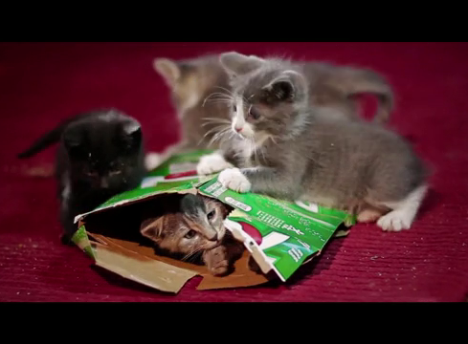
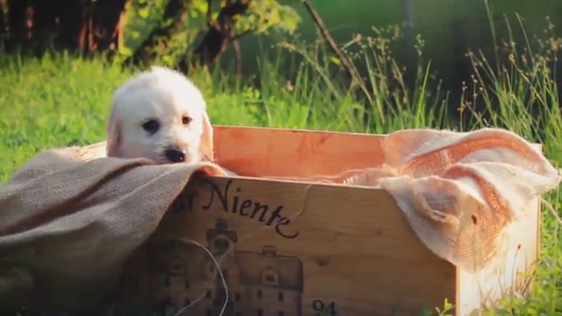
Pet video task (unscripted)
In session C
Speakers watched a ~2-minute video of cute kittens or puppies, and talked aloud to the pets as they watched
Many, but not all, used a pet-directed speech style, which is known to typically have exaggerated prosody and to show the pitch of infant-directed speech, but with less affect
Burnham et al. 2002

Slide 13
Conversation reports task (unscripted)
30 sec about a recent conversation supposedly in a “s/he said – I said” style
“reported speech”/“constructed dialog” can re-create multiple voices and/or convey stance/evaluation and thus have more voice quality variation
One per session (3 total)
Different kind of topic each session:
A: NOT important/exciting/upsetting = “neutral”
B: made the speaker really happy = “happy”
C: really annoyed the speaker = “annoyed”
Podesva 2010

Slide 14
Summary, UCLA Speaker Variability Database:
 | Session A | Session B | Session C | Amount of speech (total of 3 sessions)
isolated vowels | 3 tokens (3 sec speech) | 3 tokens (3 sec speech) | 3 tokens (3 sec speech) | ~10 sec
read sentences | 10 sentences (~25 sec speech) | 10 sentences (~25 sec speech) | 10 sentences (~25 sec speech) | ~75 sec
other speech task (unscripted) | instruction narrative (25-30 sec speech) | phonecall (60-120 sec speech) | talk to pet video (60-120 sec speech) | ~145-270 sec
reported conversations (unscripted) | neutral (25-30 sec speech) | happy (25-30 sec speech) | annoyed (25-30 sec speech) | ~75-90 sec
TOTAL | ~75-90 sec per speaker | ~110-180 sec per speaker | ~110-180 sec per speaker | ~300-450 sec per speaker

Slide 15
Transcriptions provided with the Database
Vowel tokens manually segmented
Rest of corpus is fully orthographically transcribed and then automatically segmented and labeled in Praat textgrids, using Penn’s P2FA forced aligner FAVE, or DARLA
Labels are phoneme strings in ARPABET, from dictionary look-up of orthographic words (CMU pronouncing dictionary, which has over 134,000 words, gives lexical stress, and has multiple entries for some words)
Yuan & Liberman 2008, Rosenfelder et al. 2011; Reddy & Stanford 2015

Slide 16
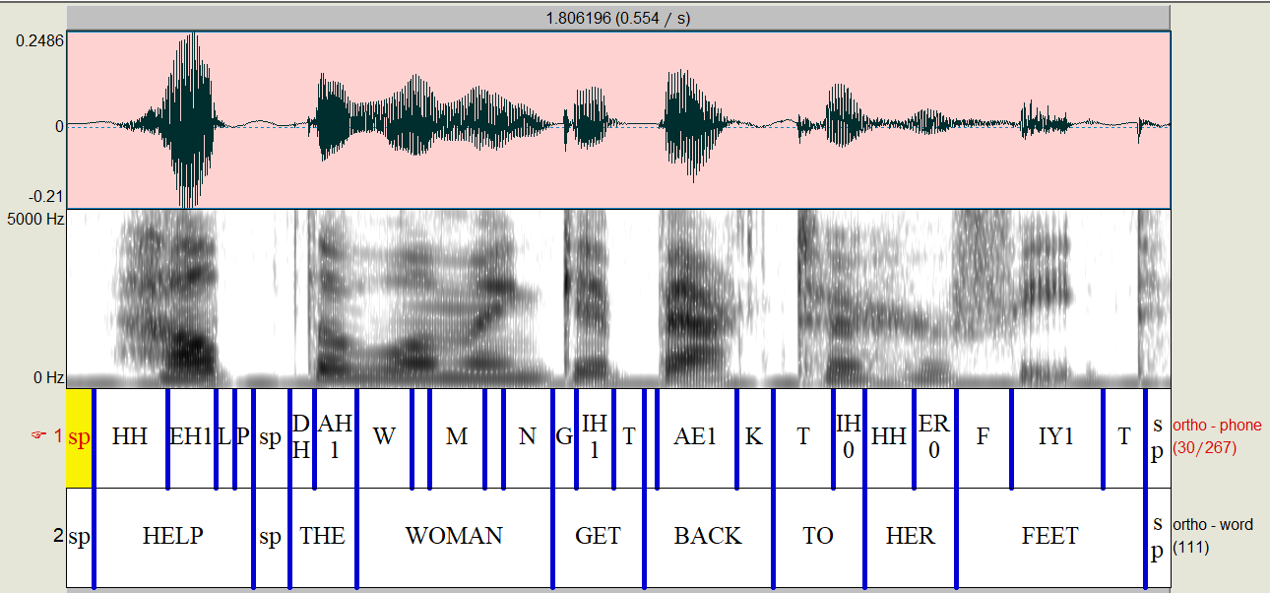
Example of output for 1 sentence

Slide 17
Public vs. project-internal
238 speakers completed all speech tasks and are available to the UCLA-internal project team
204 speakers (99 men + 105 women) completed all speech tasks and agreed to allow their recordings to be public
89 monolingual native speakers of English (42+47)
56 bilingual native speakers of English (27+29)
59 L2 speakers of English (30+29)
This public version of the database is currently available on request, will be online this year

Slide 18
Acknowledgments
NSF grants IIS-1450992, IIS-1704167 to Abeer Alwan
UCLA linguistics students who have helped in making, transcribing, and organizing the recordings
Thank you!

Slide 19
References – TO DO (get from paper)
Wolf 1972, Nolan 1983, Kinnunen & Li 2010
Yuan & Liberman 2008, Rosenfelder et al. 2011; Reddy & Stanford 2015
Podesva 2010
Burnham et al 2002
IEEE 1969
Sturim et al 2016

